Slide 1
Totara Bank project
2008 Energy Postgraduate Conference
Léa Sigot - Sylvain Lamige
Supervisor: Attilio Pigneri

Slide 2
Presentation overview
Context
Totara Bank project outlines
Previous work
On-site visit
Thermal analysis of building design and siting options
Objectives
Waitakere NOW Home®
Software review:
ALF3
Data collection:
Climate data
Techno-economic analysis of distributed generation options from renewable energy sources and grid-interaction scenarios
Objectives
Methodology
Software review:
HOMER
ViPOR
Data collection
Resource data
Technological data
Electrical demand data

Slide 3
Context of our research project within our studies
Our school:
National Institute of Applied Sciences
(INSA) of Lyon
Our department:
Energy & Environment Engineering
Our research project:
A five-month research project during our fourth year

Slide 4
Totara Bank project outlines
A sustainable land development, with:
Energy efficient houses, based on solar principle design
On-site electricity generation from renewable sources
Life in community

Slide 5
On-site visit
Site location
Plot contours
Common facilities

Slide 6
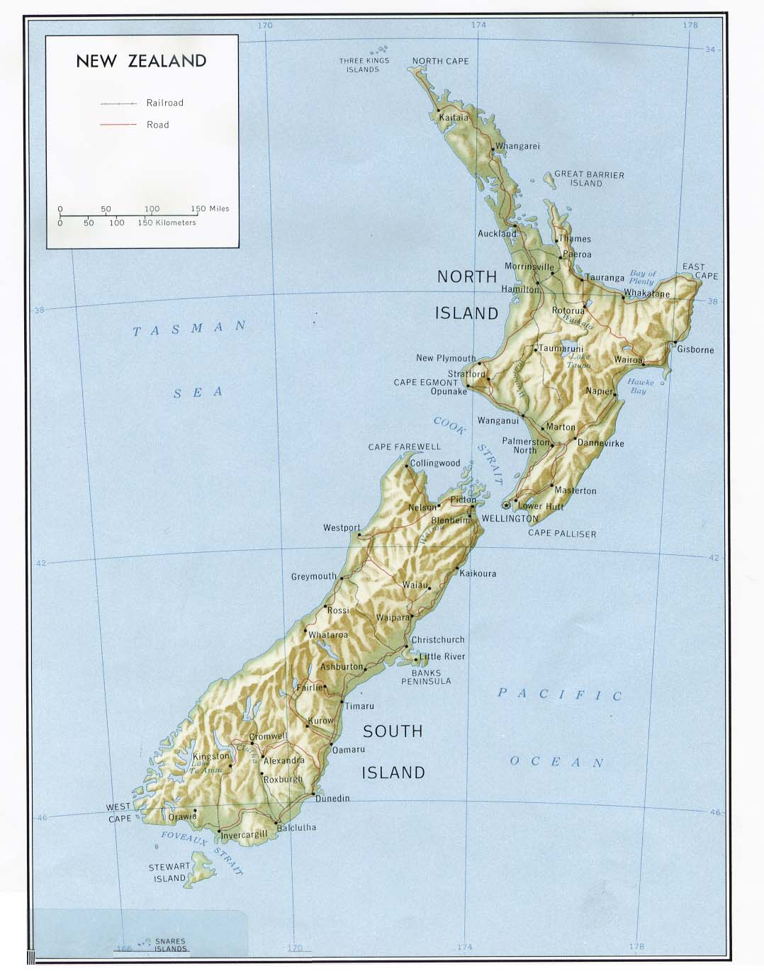
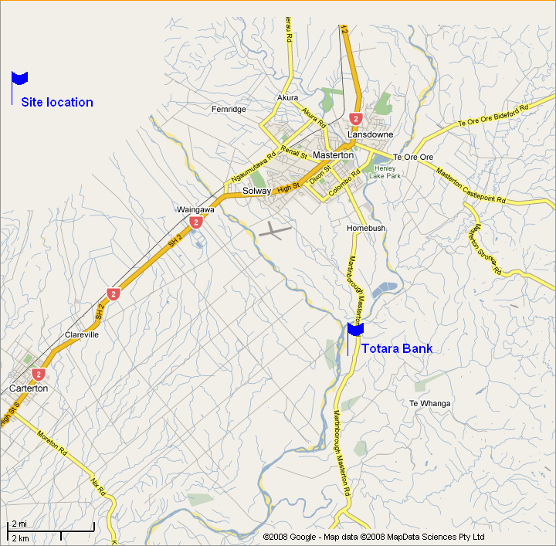
Location
8 km south of Masterton
Wairarapa district

Slide 7
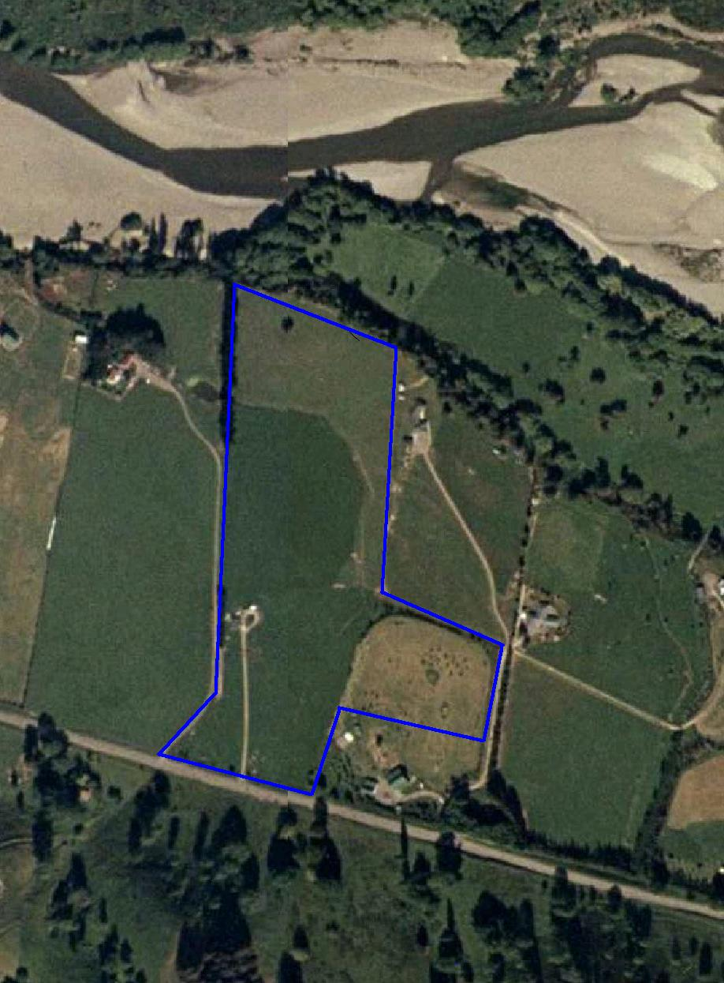
Totara Bank site
7 hectares
8 lots

Slide 8
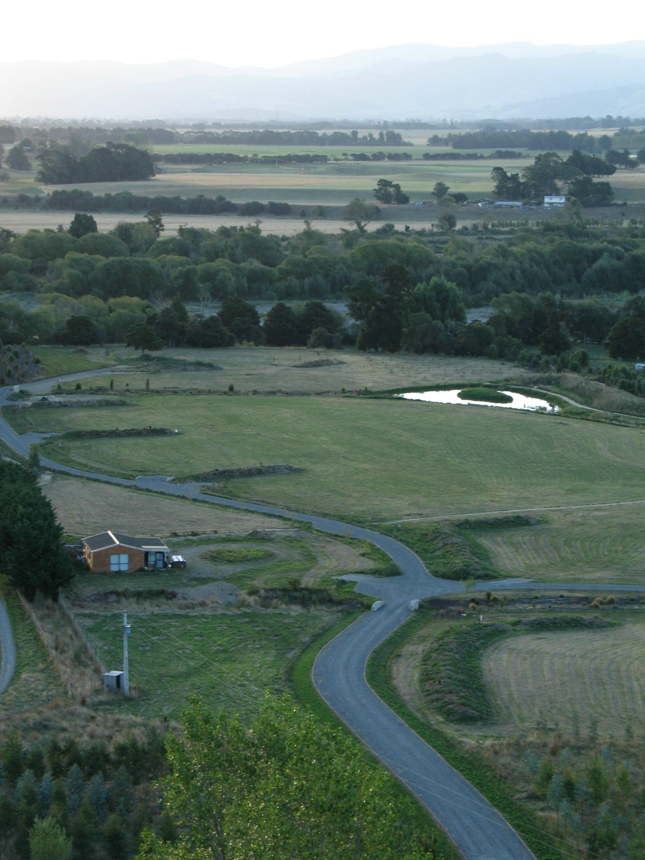
Common facilities
Common house
Road access
Pole connection
Coppicing trees

Slide 9
Previous work
Land layout
Whole solar access planning
Optimized eaves shade angles
Site thermal self-sufficiency

Slide 10
Land layout
Previous work
7 hectares:
8 individual lots (1200-2100 m²)
6 hectare common land
Soil-adapted tree plantation
An optimized land layout

Slide 11
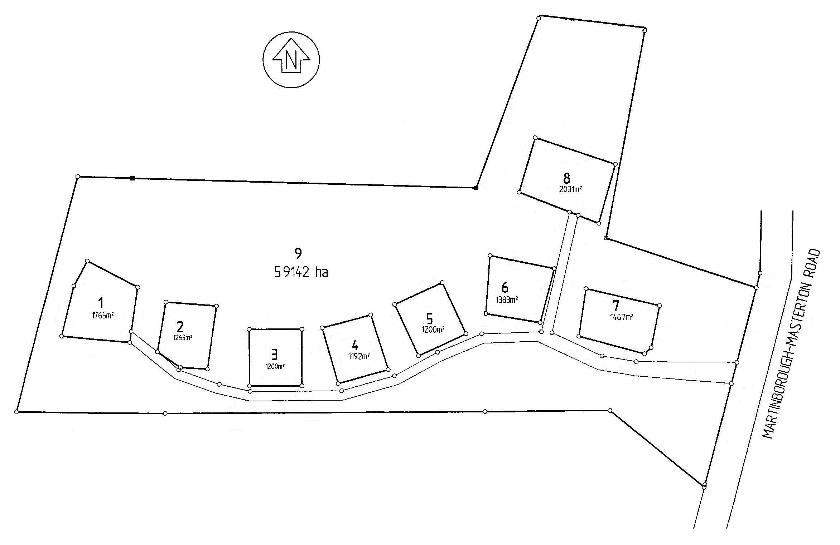
Previous work: Land layout

Slide 12
Land layout
Previous work
7 hectares:
8 individual lots (1200-2100 m²)
6 hectare common land
Soil-adapted tree plantation
An optimized land layout

Slide 13
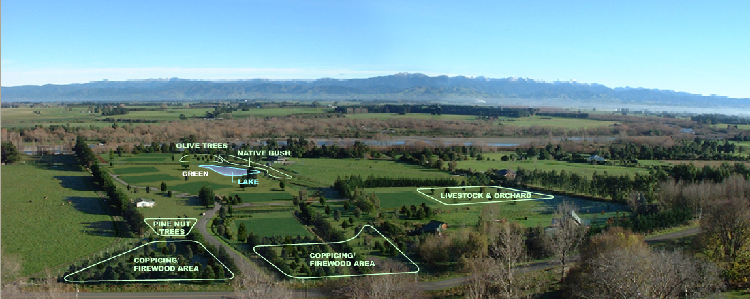
Previous work: Land layout

Slide 14
Land layout
Previous work
7 hectares:
8 individual lots (1200-2100 m²)
6 hectare common land
Soil-adapted tree plantation
An optimized land layout

Slide 15
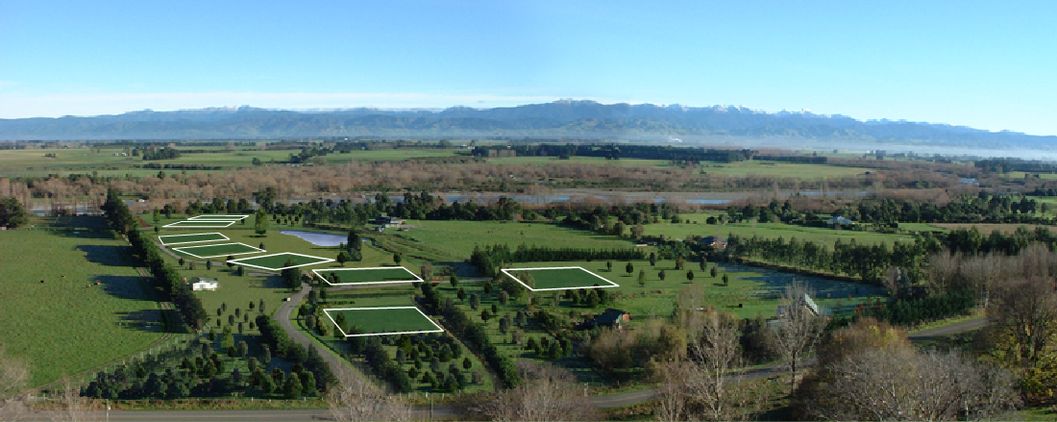
Previous work: Land layout

Slide 16
Whole solar access planning
Previous work
85 % solar energy capture
Solar obstruction contours

Slide 17
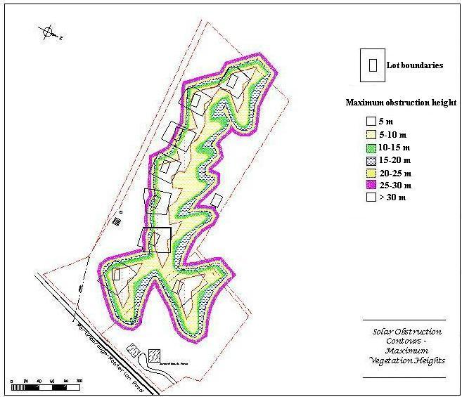
Previous work: Solar obstruction contours

Slide 18
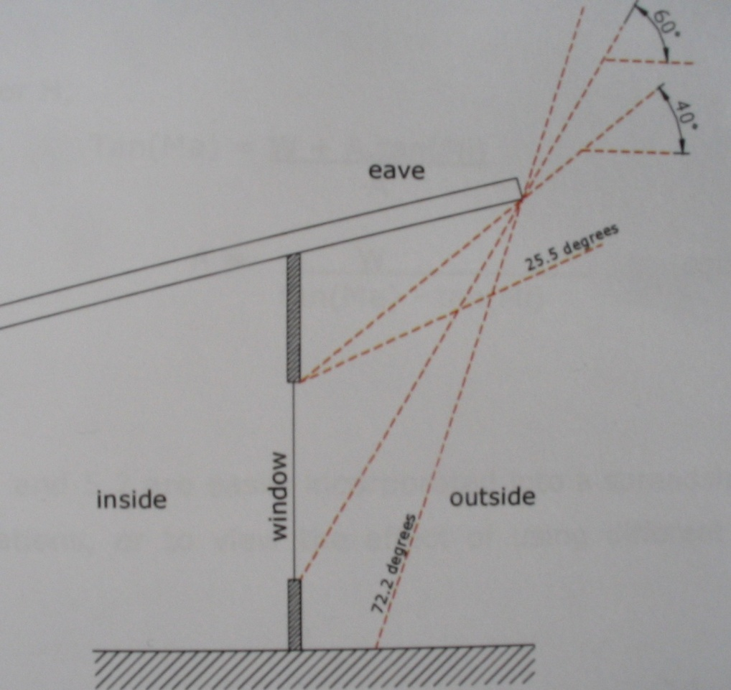
Optimized eaves shade angles
Previous work
Avoid summer over-heating and
winter under-heating
Site-suited angles
Traditional
Optimized

Slide 19
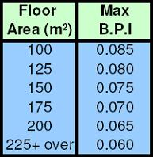
Site thermal self-sufficiency
Previous work
Dwelling minimal thermal efficiency, based on:
Building Performance Index (BPI)
Floor area
On-site fuel resource:
0.6 ha of coppicing trees

Slide 20
Thermal analysis of building design and siting options
Objectives
Waitakere NOW Home®
Software review: ALF3
Data collection

Slide 21
Objectives
Thermal analysis of buildings
Model energy performance of a baseline house
How much heating energy is required?
Is the site resource sufficient?
What can be done to improve the site thermal self-sufficiency?

Slide 22
Waitakere NOW Home®
Thermal analysis of buildings: Data collection – Dwelling characteristics
Designed, built and monitored
by Beacon Pathway Ltd
Efficient building best practices
Suit an average family
Affordable

Slide 23
Software review: ALF3
Thermal analysis of buildings
Description
Modelling capabilities
Input requirements

Slide 24
Description
Thermal analysis of buildings: Software review – ALF3
Annual Loss Factor Method
Developed by the Building Research Association of New Zealand (BRANZ)
Determine the heating energy required

Slide 25
Modelling capabilities
Thermal analysis of buildings: Software review – ALF3
Heating energy required [kWh/year]
Building Performance Index (BPI) [kWh/(DegreeDay.m²)]
Design option comparison

Slide 26
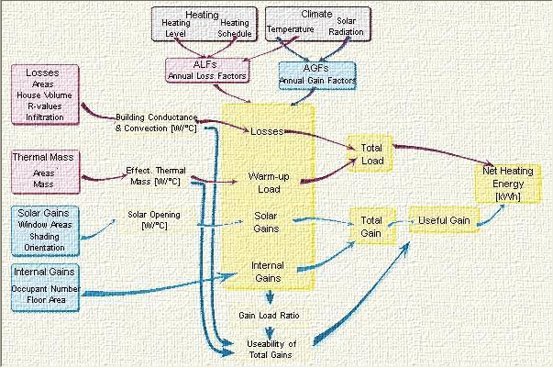
Thermal analysis of buildings: Software review – ALF3
ALF flow chart

Slide 27
Modelling capabilities
Thermal analysis of buildings: Software review – ALF3
Heating energy required [kWh/year]
Building Performance Index (BPI) [kWh/(DegreeDay.m²)]
Design option comparison

Slide 28
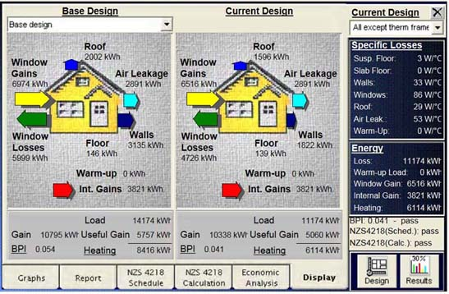
Thermal analysis of buildings: Software review – ALF3
ALF sample design comparison

Slide 29
Input requirements
Thermal analysis of buildings: Software review – ALF3
Dwelling characteristics
Occupancy behaviour
Climate region

Slide 30
Thermal analysis of buildings: Software review – ALF3
ALF flow chart

Slide 31
Input requirements
Thermal analysis of buildings: Software review – ALF3
Dwelling characteristics
Occupancy behaviour
Climate region

Slide 32
Thermal analysis of buildings: Software review – ALF3
ALF flow chart

Slide 33
Input requirements
Thermal analysis of buildings: Software review – ALF3
Dwelling characteristics
Occupancy behaviour
Climate region

Slide 34
Thermal analysis of buildings: Software review – ALF3
ALF flow chart

Slide 35
Climate data
Thermal analysis of buildings: Data collection – Climate
Meteorological station location
Long-term average monthly temperature
ALF-value calculation
Long-term average monthly sunshine hours
AGF-value calculation

Slide 36
Thermal analysis of buildings: Data collection – Climate

Slide 37
Climate data
Thermal analysis of buildings: Data collection – Climate
Meteorological station location
Long-term average monthly temperature
ALF-value calculation
Long-term average monthly sunshine hours
AGF-value calculation

Slide 38
Thermal analysis of buildings: Data collection – Climate

Slide 39
Thermal analysis of buildings: Data collection – Climate
Average Waitakere
Average Totara Bank
Average difference: 3.2 °C

Slide 40
Climate data
Thermal analysis of buildings: Data collection – Climate
Meteorological station location
Long-term average monthly temperature
ALF-value calculation
Long-term average monthly sunshine hours
AGF-value calculation

Slide 41
Thermal analysis of buildings: Data collection – Climate

Slide 42
Thermal analysis of buildings: Data collection – Climate

Slide 43
Climate data
Thermal analysis of buildings: Data collection – Climate
Meteorological station location
Long-term average monthly temperature
ALF-value calculation
Long-term average monthly sunshine hours
AGF-value calculation

Slide 44
Thermal analysis of buildings: Data collection – Climate
Heating
schedule
Evening
Morning/evening
All day
24 h

Slide 45
Thermal analysis of building design and siting options
Model template for Waitakere NOW Home® in Totara Bank site
Heating energy required for the whole Totara Bank site
Part provided by the coppicing area
To be continued…

Slide 46
Techno-economic analysis of distributed generation options from renewable energy sources and grid-interaction scenarios
Objectives
Methodology
Software review:
HOMER
ViPOR
Data collection:
Resource data
Technological data
Electrical demand data

Slide 47
Objectives
Electrical generation system analysis
Techno-economic analysis of distributed generation options from renewable energy sources
and grid-interaction scenarios
What type of generation mix?
Trade-of between electrical requirements and on-site generation costs
What electrical self-sufficiency level can be achieved?

Slide 48
Methodology
Electrical generation system analysis
Using HOMER:
Determine the optimal generation system
Using ViPOR:
Draw the local network map

Slide 49
Software review: HOMER
Electrical generation system analysis
Description
Modelling capabilities
Input requirements
Already done projects

Slide 50
Description
Electrical generation system analysis: Software review – HOMER
Developed by the American National Renewable Energy Laboratory (NREL)
Hybrid Optimization Model for Energy Renewables

Slide 51
Modelling capabilities
Electrical generation system analysis: Software review – HOMER
Generation system simulation
Energy balance
Optimisation
Ranked by cost
Sensitivity analysis

Slide 52
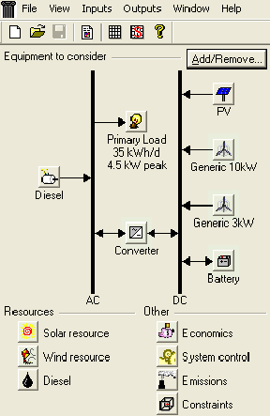
Input requirements
Electrical generation system analysis: Software review – HOMER
Resources
Technologies
Electrical demand

Slide 53
Already done projects
Electrical generation system analysis: Software review – HOMER
Sicud project:
Small village in Philippines
Wind, solar and fuel resource
Methodology
Impact of wind speed and fuel price
Usefulness of sensitivity analysis

Slide 54
Software review: ViPOR
Electrical generation system analysis: Software review – ViPOR
Description
Modelling capabilities
Input requirements

Slide 55
Description
Electrical generation system analysis: Software review – ViPOR
Developed by the American
National Renewable Energy Laboratory
The Village Power Optimization Model for Renewable
In association with HOMER

Slide 56
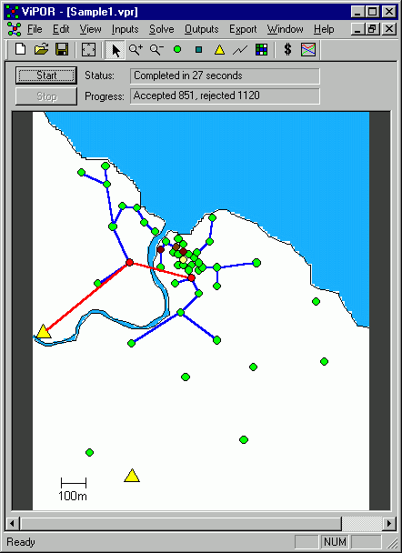
Modelling capabilities
Electrical generation system analysis: Software review – ViPOR
Intern grid design
Wire length
Load kind
Grid-interaction scenarios
Electricity price

Slide 57
Input requirements
Electrical generation system analysis: Software review – ViPOR
Spatial inputs
Non-spatial inputs

Slide 58
Resource data
Electrical generation system analysis: Data collection
Available data
Hourly wind speed and direction
Hourly global solar radiation
Profile development
Wind resource:
Long-term average hourly profile
Wind speed frequency distribution curve
Wind rose
Solar resource
Long-term average hourly profile
Daily profile per month

Slide 59
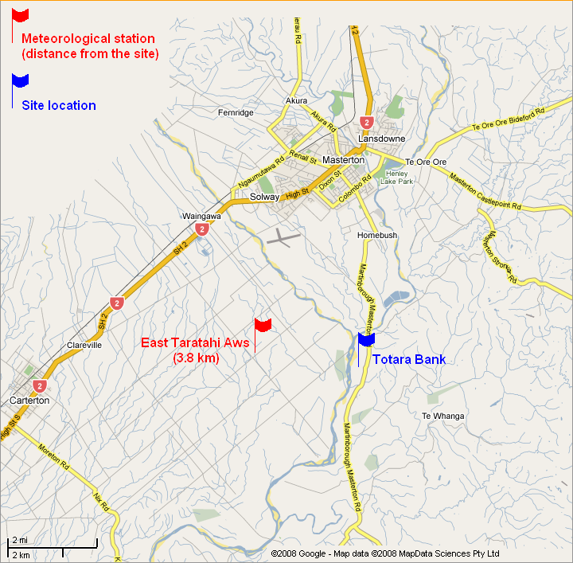
Electrical generation system analysis: Data collection – Resource

Slide 60
Resource data
Electrical generation system analysis: Data collection
Available data
Hourly wind speed and direction
Hourly global solar radiation
Profile development
Wind resource:
Long-term average hourly profile
Wind speed frequency distribution curve
Wind rose
Solar resource
Long-term average hourly profile
Daily profile per month

Slide 61
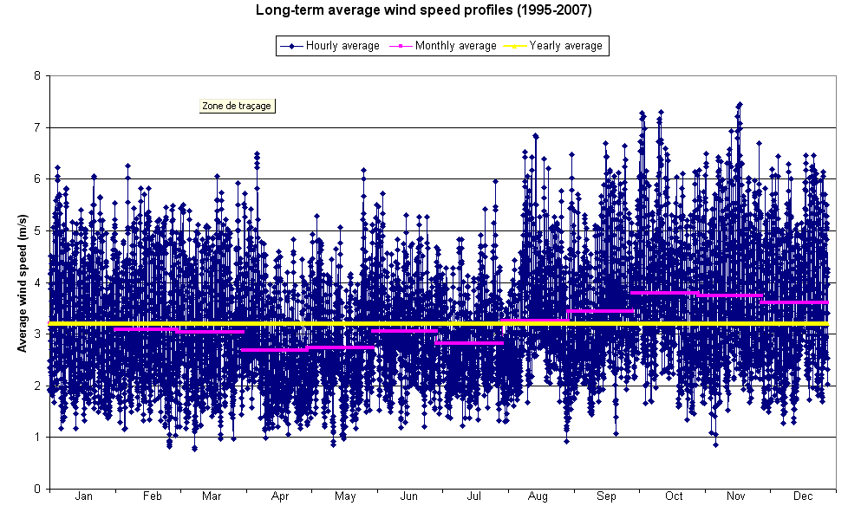
Electrical generation system analysis: Data collection – Resource
Average wind speed: 3,2 m/s

Slide 62
Resource data
Electrical generation system analysis: Data collection
Available data
Hourly wind speed and direction
Hourly global solar radiation
Profile development
Wind resource:
Long-term average hourly profile
Wind speed frequency distribution curve
Wind rose
Solar resource
Long-term average hourly profile
Daily profile per month

Slide 63
Electrical generation system analysis: Data collection – Resource
55 % of wind speed < 3 m/s

Slide 64
Resource data
Electrical generation system analysis: Data collection
Available data
Hourly wind speed and direction
Hourly global solar radiation
Profile development
Wind resource:
Long-term average hourly profile
Wind speed frequency distribution curve
Wind rose
Solar resource
Long-term average hourly profile
Daily profile per month

Slide 65
Electrical generation system analysis: Data collection – Resource

Slide 66
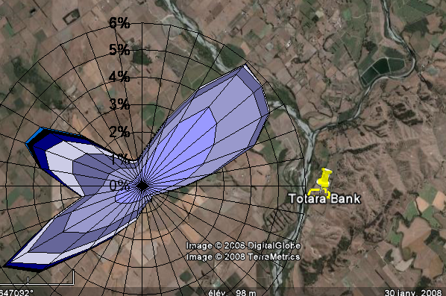
Electrical generation system analysis: Data collection – Resource

Slide 67
Resource data
Electrical generation system analysis: Data collection
Available data
Hourly wind speed and direction
Hourly global solar radiation
Profile development
Wind resource:
Long-term average hourly profile
Wind speed frequency distribution curve
Wind rose
Solar resource
Long-term average hourly profile
Daily profile per month

Slide 68
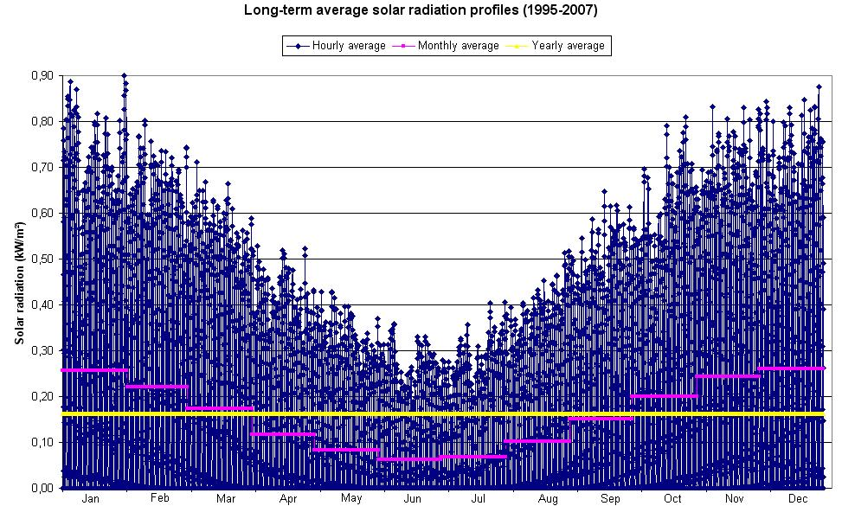
Electrical generation system analysis: Data collection – Resource

Slide 69
Resource data
Electrical generation system analysis: Data collection
Available data
Hourly wind speed and direction
Hourly global solar radiation
Profile development
Wind resource:
Long-term average hourly profile
Wind speed frequency distribution curve
Wind rose
Solar resource
Long-term average hourly profile
Daily profile per month

Slide 70
Electrical generation system analysis: Data collection – Resource

Slide 71
Next steps
Electrical generation system analysis: Data collection
Technological data
Database
Cost estimation
Electrical demand data
Hourly electrical demand record

Slide 72
Totara Bank project
2008 Energy Postgraduate Conference
Léa Sigot - Sylvain Lamige
Supervisor: Attilio Pigneri

